Slide 1
Functional Units

Slide 2
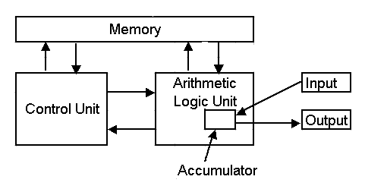
The Original Von Neumann Machine

Slide 3
Functional Units
Arithmetic
Input
and
logic
Memory
Output
Control
I/O
Processor
Basic functional units of a computer.

Slide 4
Information Handled by a Computer
Instructions/machine instructions
Govern the transfer of information within a computer as well as between the computer and its I/O devices
Specify the arithmetic and logic operations to be performed
Program
Data
Used as operands by the instructions
Source program
Encoded in binary code – 0 and 1

Slide 5
Binary Coded Decimal (Each decimal digit encoded in 4 bit)
American Standard Code for Information Interchange ( Each character is encoded in 7 bits)
Extended Binary-Coded Decimal Interchange( 8 bit are used to denote a character)

Slide 6
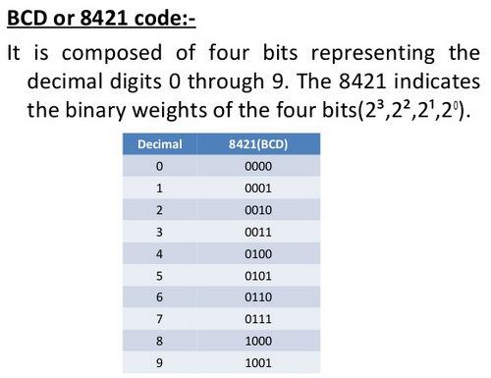

Slide 7
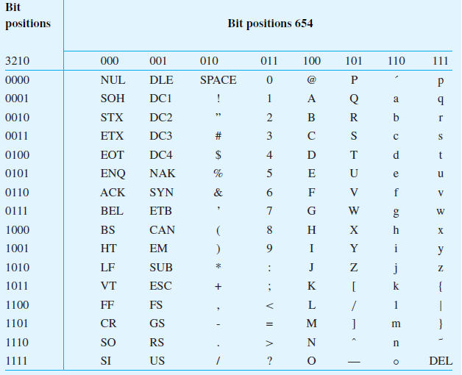
American Standard Code for Information Interchange

Slide 8
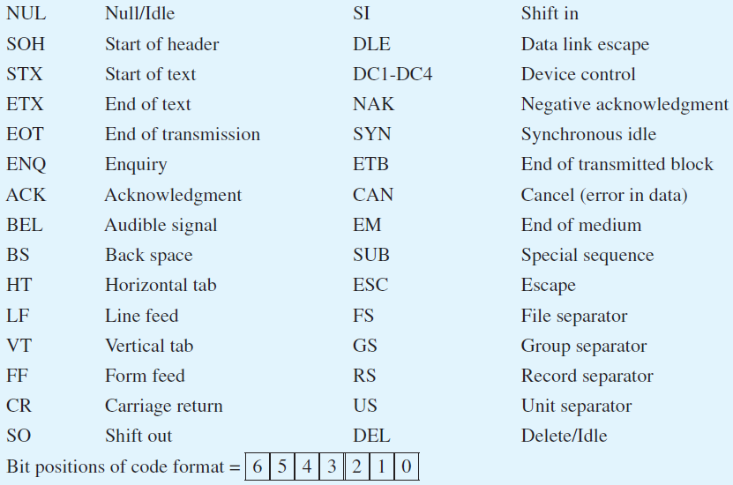

Slide 9
Memory Unit
Store programs and data
Two classes of storage
Primary storage
Fast
Programs must be stored in memory while they are being executed
Large number of semiconductor storage cells
Processed in words
Address
RAM and memory access time
Memory hierarchy – cache, main memory
Secondary storage – larger and cheaper

Slide 10
Arithmetic and Logic Unit (ALU)
Most computer operations are executed in ALU of the processor.
Load the operands into memory – bring them to the processor – perform operation in ALU – store the result back to memory or retain in the processor.
Registers
Fast control of ALU

Slide 11
Control Unit
All computer operations are controlled by the control unit.
The timing signals that govern the I/O transfers are also generated by the control unit.
Control unit is usually distributed throughout the machine instead of standing alone.
Operations of a computer:
Accept information in the form of programs and data through an input unit and store it in the memory
Fetch the information stored in the memory, under program control, into an ALU, where the information is processed
Output the processed information through an output unit
Control all activities inside the machine through a control unit

Slide 12
Basic Operational Concepts

Slide 13
Review
Activity in a computer is governed by instructions.
To perform a task, an appropriate program consisting of a list of instructions is stored in the memory.
Individual instructions are brought from the memory into the processor, which executes the specified operations.
Data to be used as operands are also stored in the memory.

Slide 14
A Typical Instruction
Add LOCA, R0
Add the operand at memory location LOCA to the operand in a register R0 in the processor.
Place the sum into register R0.
The original contents of LOCA are preserved.
The original contents of R0 is overwritten.
Instruction is fetched from the memory into the processor – the operand at LOCA is fetched and added to the contents of R0 – the resulting sum is stored in register R0.

Slide 15
Separate Memory Access and ALU Operation
Load LOCA, R1
Add R1, R0
Whose contents will be overwritten?

Slide 16
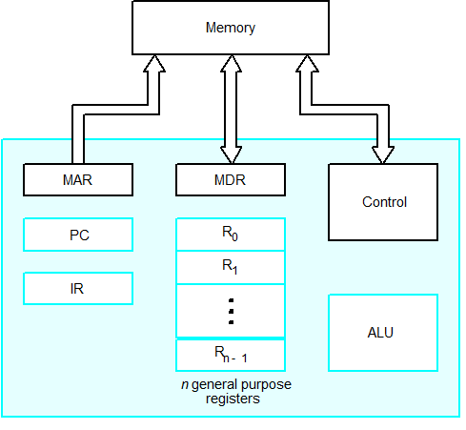
Connection Between the Processor and the Memory

Slide 17
Registers
Instruction register (IR)
Program counter (PC)
General-purpose register (R₀ – R_{n-1})
Memory address register (MAR)
Memory data register (MDR)

Slide 18
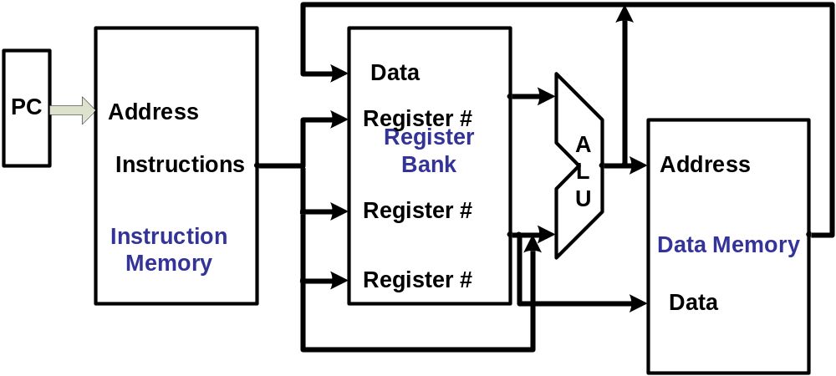
The processor : Data Path and Control
Two types of functional units:
  elements that operate on data values (combinational)
  elements that contain state (state elements)

Slide 19
Typical Operating Steps
Programs reside in the memory through input devices
PC is set to point to the first instruction
The contents of PC are transferred to MAR
A Read signal is sent to the memory
The first instruction is read out and loaded into MDR
The contents of MDR are transferred to IR
Decode and execute the instruction

Slide 20
Typical Operating Steps (Cont’)
Get operands for ALU
  General-purpose register
  Memory (address to MAR – Read – MDR to ALU)
Perform operation in ALU
Store the result back
  To general-purpose register
  To memory (address to MAR, result to MDR – Write)
During the execution, PC is incremented to the next instruction

Slide 21
Interrupt
Normal execution of programs may be preempted if some device requires urgent servicing.
The normal execution of the current program must be interrupted – the device raises an interrupt signal.
Interrupt-service routine
Current system information backup and restore (PC, general-purpose registers, control information, specific information)

Slide 22
Bus Structures
There are many ways to connect different parts inside a computer together.
A group of lines that serves as a connecting path for several devices is called a bus.
Address/data/control

Slide 23
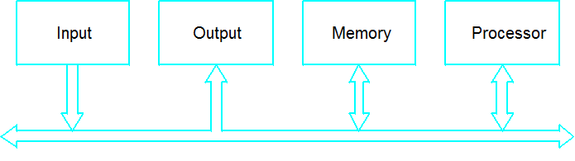
Bus Structure
Single-bus

Slide 24
Speed Issue
Different devices have different transfer/operate speed.
If the speed of bus is bounded by the slowest device connected to it, the efficiency will be very low.
How to solve this?
A common approach – use buffers.

Slide 25
Another Way of thinking

Slide 26
A large gap between what is convenient for people and what is convenient for computers
Solutions
  Translation – entire program is translated into new language before being executed.
  Interpretation – each instruction is examined and decoded, and then executed.
Can create abstraction using virtual machines, each with it’s own machine language
Languages should not be too different

Slide 27
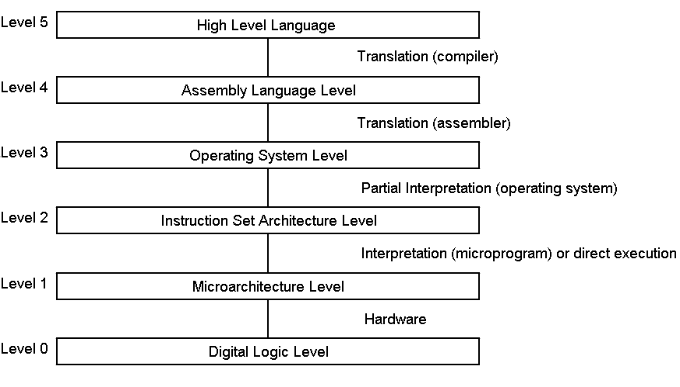
Virtual Machine Levels 0 through 5

Slide 28
Multilevel Machines
Level 0 – Digital Logic Level
  Gate level, made from transistors, used to form 1-bit memories. Memories combined to form 16,32, or 64-bit registers.
  Level 1 – Microarchitecture Level
  Collection of 8-32 registers that form a local memory and a circuit called an ALU (Arithmetic Logic Unit). Registers and ALU connected to form a data path. Data path may be controlled by software or hardware. Does fetching, examining, and executing of instructions, either through an interpreter or hardwired control.

Slide 29
Multilevel Machines
Level 2 – Instruction Set Architecture
  The instructions that are carried out interpretively by the underlying levels. Everything lower is proprietary.
Level 3 – Operating System Machine Level
  A new set of instructions (as well as those from level 2), a different memory organization, the ability to run 2 or more programs concurrently, various other features. Hybrid level.

Slide 30
Multilevel Machines
Level 4 – Assembly Language Level
  Finally have words and abbreviations rahter than just numbers. A symbolic form for one of the underlying languages.
Level 5 – High-level Language Level
  Languages designed to used by applications programmers.

Slide 31
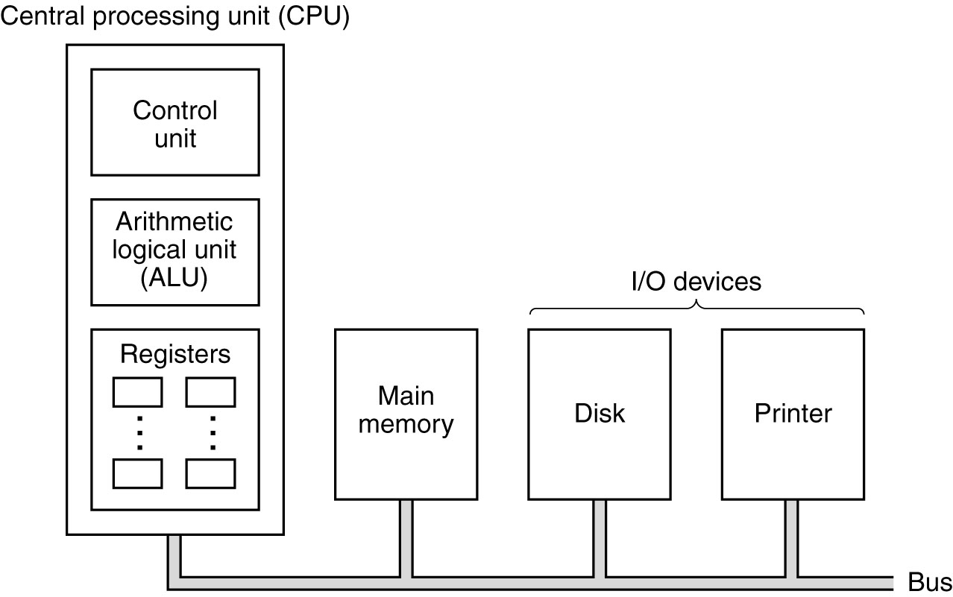
Central Processing Unit
The organization of a simple computer with
one CPU and two I/O devices

Slide 32
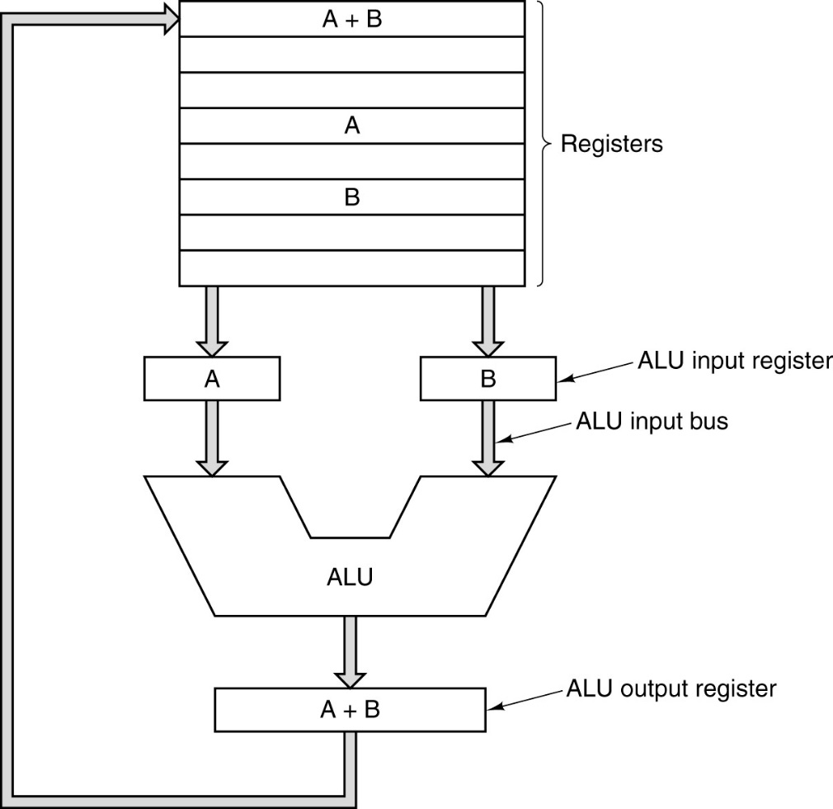
CPU Organization
The data path of a typical Von Neumann machine.

Slide 33
Register- Memory Instruction
Register-Register Instruction

Slide 34
Instruction Execution Steps
Fetch next instruction from memory into instr. register
Change program counter to point to next instruction
Determine type of instruction just fetched
If instructions uses word in memory, determine where Fetch word, if needed, into CPU register
Execute the instruction
Go to step 1 to begin executing following instruction

Slide 35
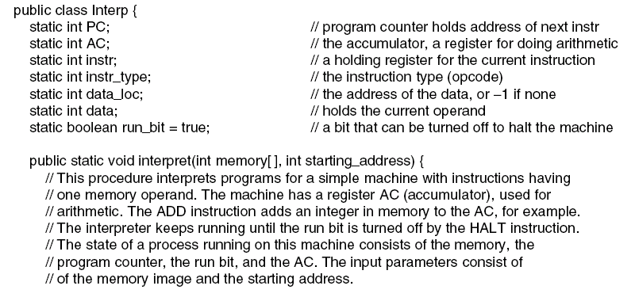
Interpreter (1)
. . .
An interpreter for a simple computer (written in Java).

Slide 36
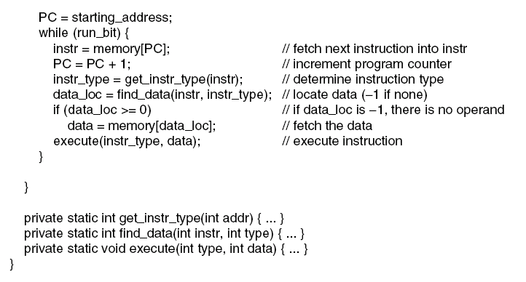
Interpreter (2)
An interpreter for a simple computer (written in Java).

Slide 37
Design Principles for Modern Computers
All instructions directly executed by hardware
Maximize rate at which instructions are issued
Instructions should be easy to decode
Only loads, stores should reference memory
Provide plenty of registers

Slide 38


Slide 39
Performance

Slide 40
Performance
The most important measure of a computer is how quickly it can execute programs.
Three factors affect performance:
Hardware design
Instruction set
Compiler

Slide 41
Performance
Processor time to execute a program depends on the hardware involved in the execution of individual machine instructions.
Main
Cache
memory
memory
Processor
Bus

Slide 42
Performance
The processor and a relatively small cache memory can be fabricated on a single integrated circuit chip.
Speed
Cost
Memory management

Slide 43
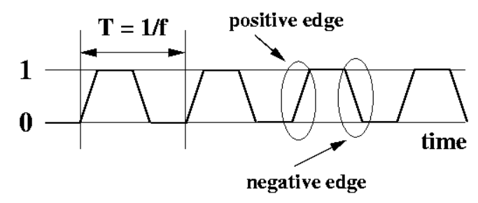
Processor Clock
Clock, clock cycle, and clock rate
The execution of each instruction is divided into several steps, each of which completes in one clock cycle.
Clock Rate= 1/P (Cycles per second)
Hertz – cycles per second
Million means Mega and billion means Giga (500 Million cycle per second is 500 MHz and 1250 million cycle per second is 1.25 GHz)

Slide 44
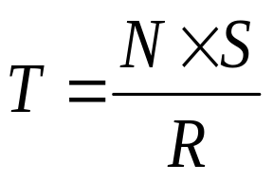
Basic Performance Equation
T – processor time required to execute a program that has been prepared in high-level language
N – number of actual machine language instructions needed to complete the execution (note: loop)
S – average number of basic steps needed to execute one machine instruction. Each step completes in one clock cycle
R – clock rate
Note: these are not independent to each other
How to improve T?

Slide 45
Pipeline and Superscalar Operation
Instructions are not necessarily executed one after another.
The value of S doesn’t have to be the number of clock cycles to execute one instruction.
Pipelining – overlapping the execution of successive instructions.
Add R1, R2, R3
Superscalar operation – multiple instruction pipelines are implemented in the processor.
Goal – reduce S (could become <1!)

Slide 46
Clock Rate
Increase clock rate
Improve the integrated-circuit (IC) technology to make the circuits faster
Reduce the amount of processing done in one basic step (however, this may increase the number of basic steps needed)
Increases in R that are entirely caused by improvements in IC technology affect all aspects of the processor’s operation equally except the time to access the main memory.

Slide 47
CISC and RISC
Tradeoff between N and S
A key consideration is the use of pipelining
S is close to 1 even though the number of basic steps per instruction may be considerably larger
It is much easier to implement efficient pipelining in processor with simple instruction sets
Reduced Instruction Set Computers (RISC)
Complex Instruction Set Computers (CISC)

Slide 48
Compiler
A compiler translates a high-level language program into a sequence of machine instructions.
To reduce N, we need a suitable machine instruction set and a compiler that makes good use of it.
Goal – reduce N×S
A compiler may not be designed for a specific processor; however, a high-quality compiler is usually designed for, and with, a specific processor.

Slide 49
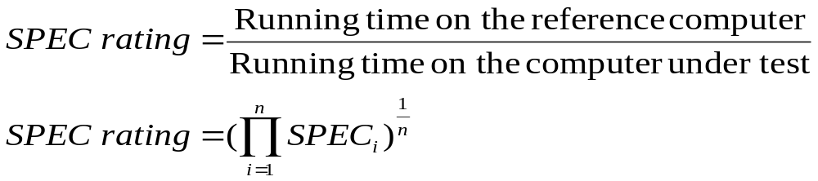
Performance Measurement
T is difficult to compute.
Measure computer performance using benchmark programs.
System Performance Evaluation Corporation (SPEC) selects and publishes representative application programs for different application domains, together with test results for many commercially available computers.
Compile and run (no simulation)
Reference computer

Slide 50
Multiprocessors and Multicomputers
Multiprocessor computer
Execute a number of different application tasks in parallel
Execute subtasks of a single large task in parallel
All processors have access to all of the memory – shared-memory multiprocessor
Cost – processors, memory units, complex interconnection networks
Multicomputers
Each computer only have access to its own memory
Exchange message via a communication network – message-passing multicomputers

Slide 51
Steps needed to execute the machine instruction
Load R2, LOC
Send the address of the instruction word from register PC to the memory and issue a Read control command.
Wait until the requested word has been retrieved from the memory, then load it into register IR, where it is interpreted (decoded) by the control circuitry to determine the operation to be performed.
Increment the contents of register PC to point to the next instruction in memory.
Send the address value LOC from the instruction in register IR to the memory and issue a Read control command.
Wait until the requested word has been retrieved from the memory, then load it into register R2.

Slide 52
Question
(a)Give a short sequence of machine instructions for the task “Add the contents of memory location A to those of location B, and place the answer in location C”. Instructions
Load Ri, LOC
and
Store Ri, LOC
are the only instructions available to transfer data between the memory and the general purpose registers.
Add instructions are described “Add LOCA, R0”. Do not change the contents of either location A or B.

Slide 53
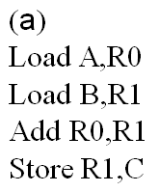

Slide 54
(b) Suppose that Move and Add instructions are available with the formats
Move Location1, Location2
and
Add Location1, Location2
These instructions move or add a copy of the operand at the second location to the first location, overwriting the original operand at the first location. Either or both of the operands can be in the memory or the general-purpose registers. Is it possible to use fewer instructions of these types to accomplish the task in part (a)? If yes, give the sequence.

